Slide 1
Code hustlers 2.0
Basic app development using
python and Mysql

Slide 2
index
Advantages Of Python Over Other Programming Languages
How to install python and its idle.
Python interpreter
Visual studio code
pycharm
How to install python modules (tkinter).
How to build the front end of the app using tkinter module.
Some beautification tricks to make your code look good.

Slide 3
Advantages Of Python Over Other Programming Languages
It's Free.
It's Easy to Use.
It's Highly Compatible.
It is Object-Oriented.
It has Lots of Libraries.
It's Widely Applicable.

Slide 4
How to install python idle
Step 1: Open the official python website and download the “windows executable installer”.
Step 2: After downloading, run the executable file.
Step 3: follow the instructions in the file window.
Step 4: select “add path” checkbox and then click next.
Step 5: select “pip” checkbox and then click next and install.

Slide 5
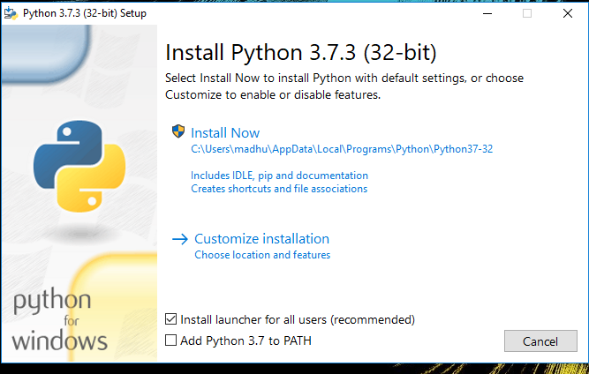

Slide 6
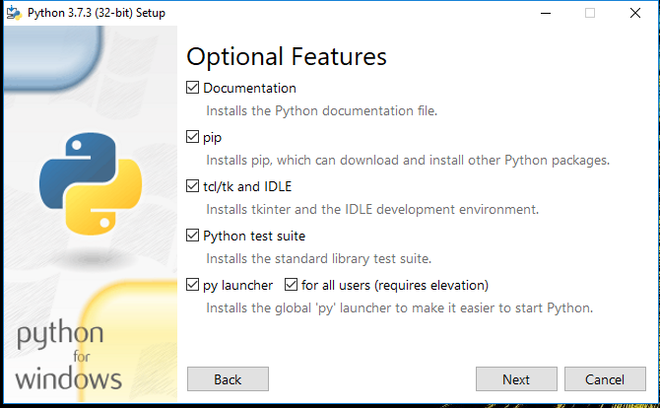

Slide 7
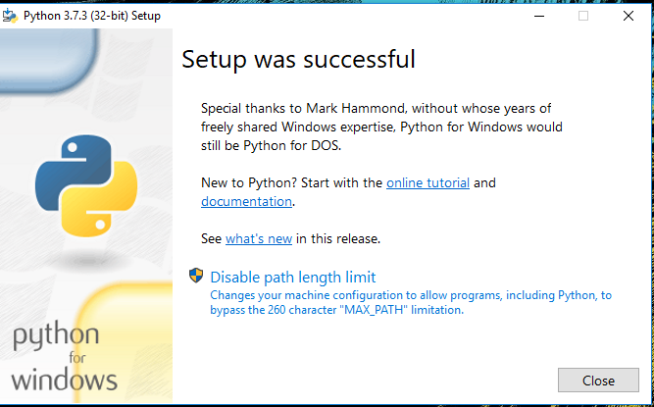

Slide 8
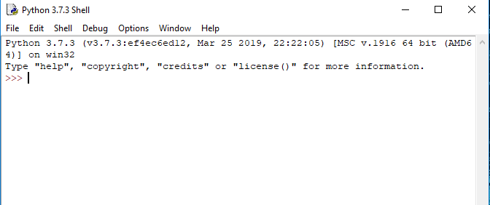

Slide 9
Differences between Scripts mode and Interactive Mode
Interactive mode: Interactive mode is where you type your code into the Python interpreter directly. This is useful for trying out small snippets of code, or for testing things out as you’re writing them.
Script mode: Script mode is where you write your code in a .py file and then run it with the python command. This is the most common way that people use Python because it lets you write and save your code so that you can use it again later.

Slide 10
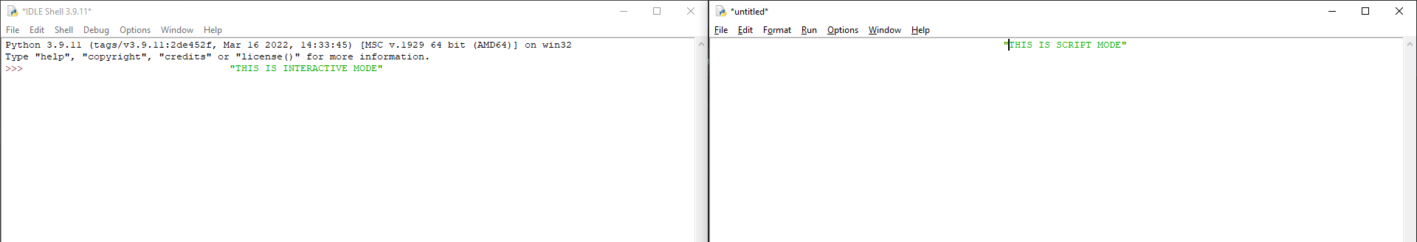
DIFFERENCE BETWEEN INTERECTIVE VS SCRIPT MODE

Slide 11
Visual studio code
Visual Studio Code, also commonly referred to as VS Code, is a source-code editor made by Microsoft with the Electron Framework.
It works on Windows, Linux and macOS.
It supports multiple languages as a code editor.

Slide 12
How to install vscode
Step 1: Visit the official website of the Visual Studio Code using any web browser.
Step 2: Press the “Download for Windows” button on the website to start the download of the Visual Studio Code Application.
Step 3: Install the setup.
Step 4: launch the application.
Step 5: Move to extension page and install python module.
Step 6: Now we are good to go.

Slide 13
pycharm

